Slide 1



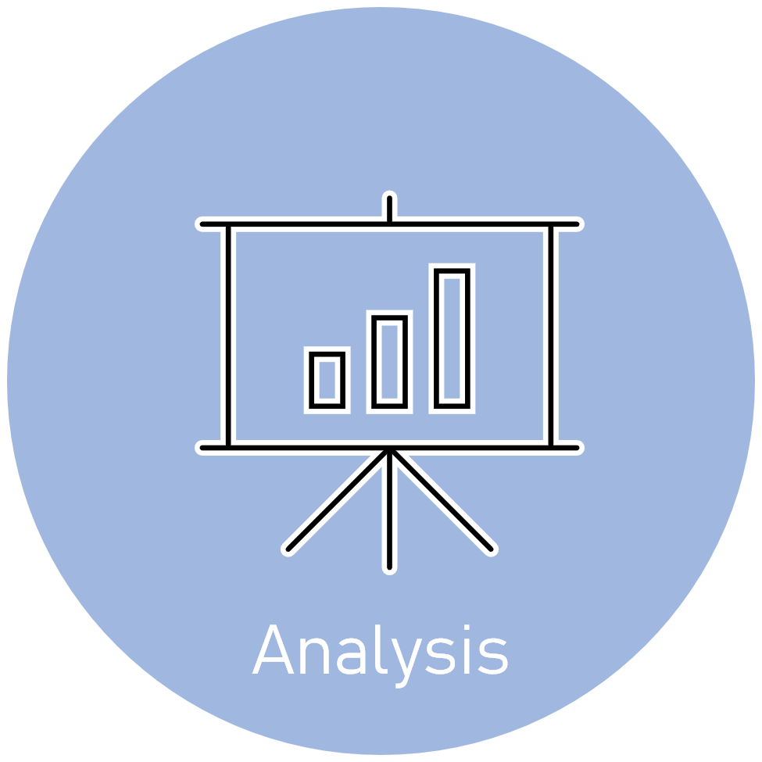




Slide 2



Data
Preparation
Developer Survey is collected from over 80K respondents throughout 2019

Slide 3
Data
Preparation
Developer Survey is collected from over 80K respondents throughout 2019

Slide 4

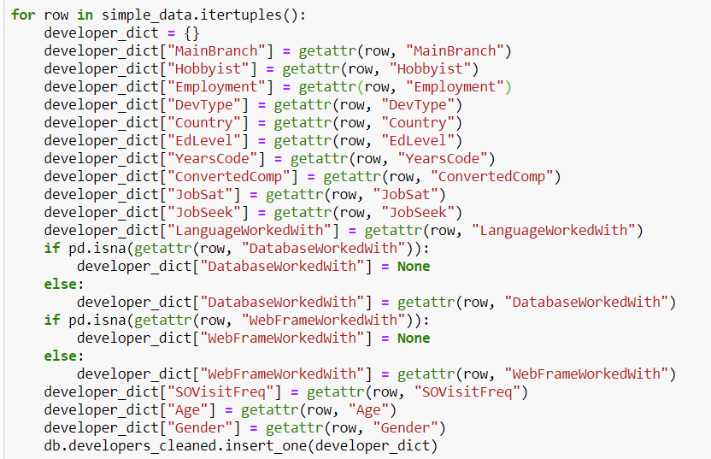
Data
Cleaning
&
MongoDB

Slide 5
Data
Cleaning
&
MongoDB
The dataset was very clean and had lots of information that can be used for different types of analysis

Slide 6



CODING

Slide 7
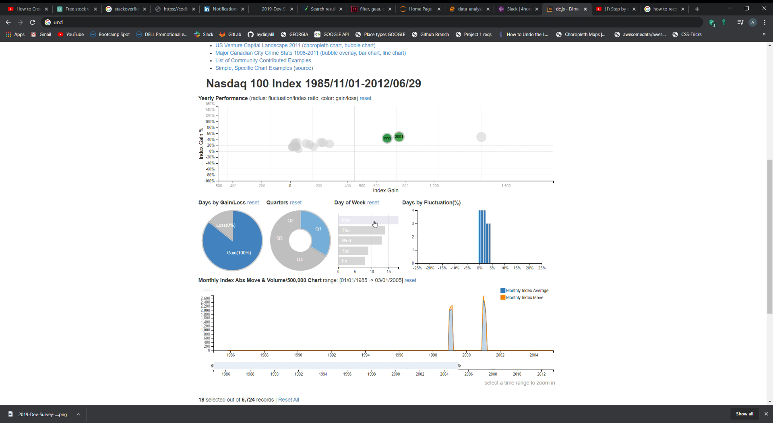
Why?
The project exploited DC.js
Library of Javascript for its
ability to work efficiently with large dimensional datasets and its native support of Crossfilter.

Slide 8
Pros
Great data visualization.
Performs graphical filtering.
Fast creation of charts and dashboards.
Creation of highly interactive dashboards.
Cons
Extremely buggy.
Lots of workarounds even for the simplest tasks.
Many conflicting solutions.

Slide 9
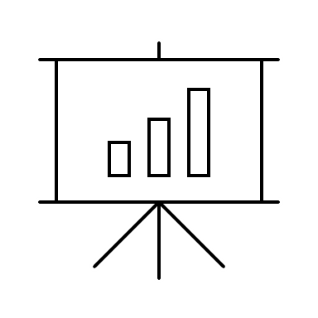


Analysis

Slide 10
What?
This project was aimed at building interactive charts showing the relationships between Development Type, Programming Languages used, Compensation of respondents (converted to USD), and Job Satisfaction.

Slide 11
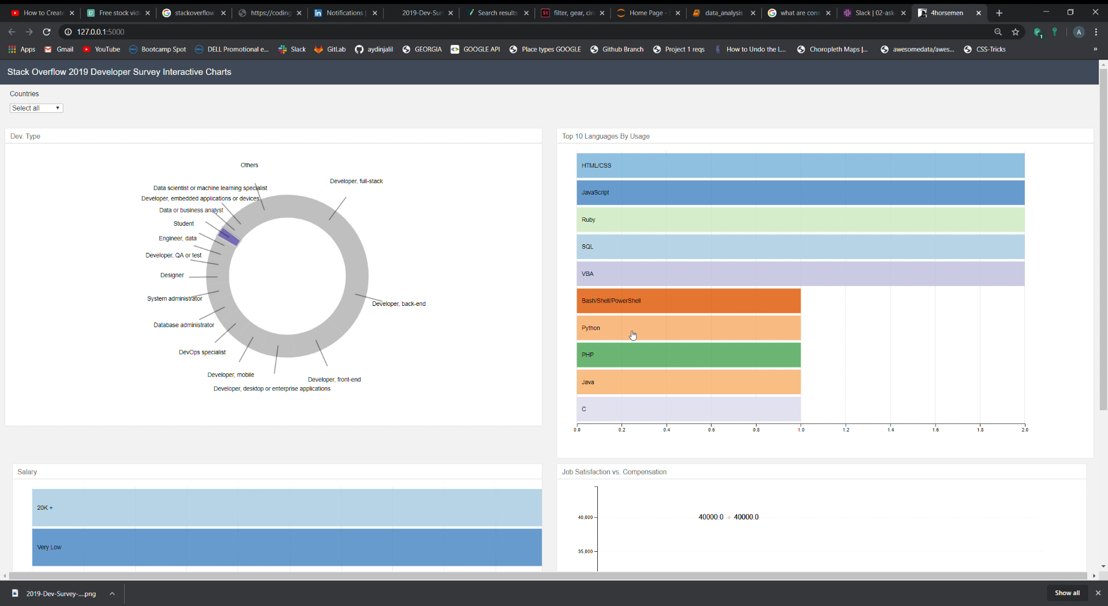
Results?
The resulting tool is visually pleasing and easy to use. By clicking on specific parts of the charts, the user can get an idea on which languages are most popular in a specific domain, as well as the most common compensations. Information about job satisfaction relative to the compensation is made available to user in a boxplot chart. All of this can be filtered by country which is a drop-down menu.

